Slide 1
Introduction to NumPy

Slide 2
What is NumPy?
NumPy is the foundation for fast, efficient numerical operations in Python. It powers data analysis, machine learning, and scientific computing workflows.
NumPy = Numerical Python
Core library for numerical computations in Python
Supports multi-dimensional arrays and matrix operations
Widely used in Data Analysis, Machine Learning, and Scientific Computing
Example:
# Python list vs NumPy array py_list = [1, 2, 3] np_array = np.array([1, 2, 3])

Slide 3
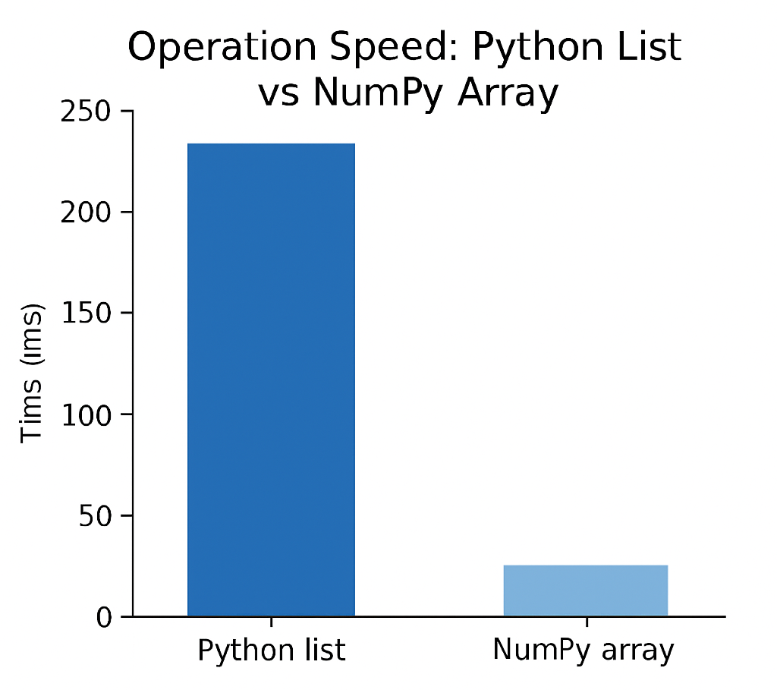
Why Use NumPy?
Efficient memory usage: NumPy arrays use less memory than Python lists for large datasets
Fast element-wise operations: Vectorized operations are much faster than Python loops
Rich library of mathematical functions: Includes linear algebra, statistics, and random number generation
Speed Comparison Example:
Operation | Python List | NumPy Array
Element-wise add (1M) | ~100 ms | ~1 ms
Matrix multiply (100x100) | ~1 s | ~0.0001 s

Slide 4

Installing & Importing NumPy
Install NumPy using : pip install numpy
Import NumPy using : import numpy as np
Aliasing as np is standard convention

Slide 5
Creating Arrays
np.array() → 1D array
np.zeros((2,3)) → 2x3 array of zeros
np.ones((3,2)) → 3x2 array of ones
np.arange(0,10,2) → Array from 0 to 8 with step 2
np.linspace(0,1,5) → 5 evenly spaced numbers between 0 and 1
Example:
np.array([1,2,3]) # [1 2 3] np.zeros((2,3)) # [[0. 0. 0.] # [0. 0. 0.]] np.arange(0,10,2) # [0 2 4 6 8] np.linspace(0,1,5) # [0. 0.25 0.5 0.75 1. ]

Slide 6
Array Operations
Element-wise Operations
Operations like +, -, *, / are applied element by element.
Works with arrays of the same shape.
Universal Functions (ufuncs)
NumPy functions operate element-wise on arrays:
np.sin(), np.cos(), np.log(), np.exp(), np.sqrt()
Broadcasting
Allows operations on arrays of different shapes.
NumPy automatically expands the smaller array along missing dimensions.
Example:
arr1 = np.array([1,2,3]) arr2 = np.array([4,5,6]) arr1 + arr2 # [5 7 9] np.exp(arr1) # [2.718 7.389 20.085]
Output array([ 2.71828183, 7.3890561 , 20.08553692])

Slide 7
Array Manipulation
Reshape: Change array shape without modifying data
Syntax: arr.reshape(new_shape)
Flatten: Convert multi-dimensional array to 1D
arr.ravel() or arr.flatten()
Concatenate: Combine arrays along an axis
Syntax: np.concatenate([arr1, arr2], axis=0)
Split: Divide array into sub-arrays
Syntax: np.split(arr, number_of_splits)
Transpose: Swap rows and columns (2D arrays)
Syntax: arr.T

Slide 8
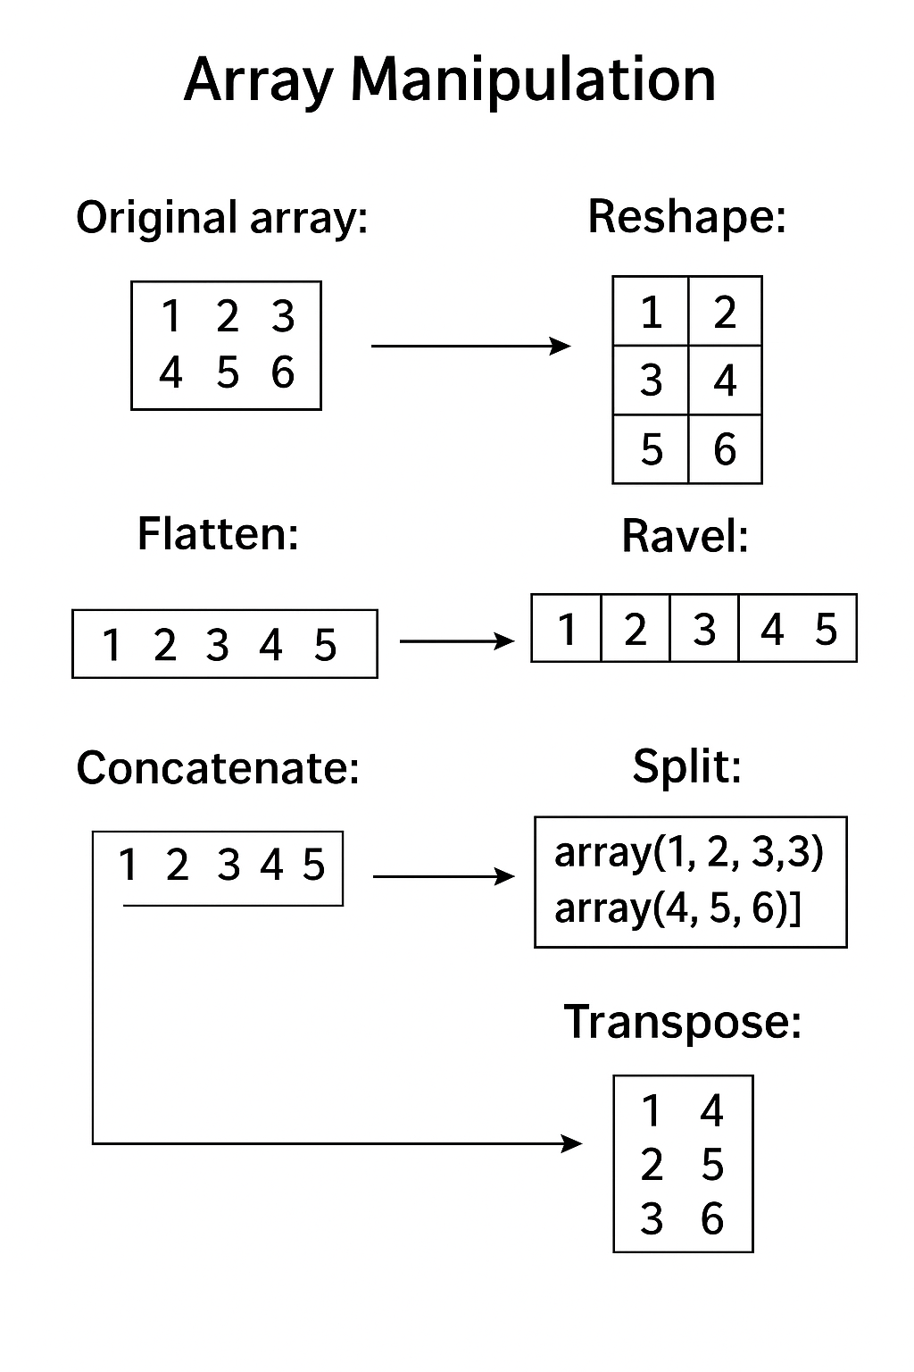
Example of Array Manipulation
import numpy as np arr = np.array([[1, 2, 3], [4, 5, 6]]) print("Original array:") print(arr, "\n") # 1. Reshape reshaped = arr.reshape(3, 2) print("Reshaped array (3x2):") print(reshaped, "\n") # 2. Flatten flattened = arr.flatten() print("Flattened array:") print(flattened, "\n") # 3. Ravel raveled = arr.ravel() print("Raveled array:") print(raveled, "\n")
# 4. Concatenate arr1 = np.array([1, 2, 3]) arr2 = np.array([4, 5, 6]) concatenated = np.concatenate([arr1, arr2]) print("Concatenated array:") print(concatenated, "\n") # 5. Split split_arr = np.split(concatenated, 2) print("Split array into 2 parts:") print(split_arr, "\n") # 6. Transpose transposed = arr.T print("Transposed array:") print(transposed)
Output :

Slide 9
Statistical Operations
Some Common NumPy Functions are :
Sum: np.sum(arr) → Total of all elements
Mean: np.mean(arr) → Average value
Median: np.median(arr) → Middle value
Standard Deviation / Variance: np.std(arr), np.var(arr) → Measure of spread
Minimum / Maximum: np.min(arr), np.max(arr) → Smallest and largest values
Axis-wise operations:
arr.sum(axis=0) → Sum of each column
arr.sum(axis=1) → Sum of each row

Slide 10
Example of Statistical Operations
Operation | NumPy Function | Example
Sum | np.sum(arr) | np.sum(arr) → 21
Mean | np.mean(arr) | np.mean(arr, axis=0) → [2.5 3.5 4.5]
Median | np.median(arr) | np.median(arr) → 3.5
Standard Deviation | np.std(arr) | np.std(arr) → 1.7078
Variance | np.var(arr) | np.var(arr) → 2.9167
Minimum | np.min(arr) | np.min(arr) → 1
Maximum | np.max(arr) | np.max(arr) → 6
Axis-wise Sum | arr.sum(axis=0) | Column-wise sum: [5 7 9]

Slide 11
Generating Random Numbers with NumPy
Uniform Distribution: Random numbers between 0 and 1
np.random.rand(rows, cols)
Normal Distribution: Random numbers from standard normal distribution
np.random.randn(rows, cols)
Random Integers: Random integers in a given range
np.random.randint(low, high, size)
Shuffle Array: Randomly rearranges elements in-place
np.random.shuffle(arr)

Slide 12
Example of Statistical Operations
Type | Function | Example
Uniform | np.random.rand(rows, cols) | np.random.rand(2,2) → [[0.1 0.7], [0.3 0.9]]
Normal | np.random.randn(rows, cols) | np.random.randn(2,2)
Random Integers | np.random.randint(low, high, size) | np.random.randint(1,5,4) → [2 4 1 3]
Shuffle | np.random.shuffle(arr) | np.random.shuffle(arr)

Slide 13
NumPy vs Python List
Feature | Python List | NumPy Array
Storage | Stores elements as objects | Stores elements in contiguous memory (efficient)
Performance | Slower for large datasets | Faster due to vectorized operations
Operations | Element-wise operations require loops | Supports element-wise operations directly
Memory Usage | Higher | Lower (more memory-efficient)
Functionality | Limited math operations | Extensive mathematical and statistical functions
Multidimensional Support | Nested lists | Native support for multidimensional arrays
Example:
Python list multiplication (1 million elements): ~ 64 ms
NumPy array multiplication (1 million elements): ~ 1.3 ms

Slide 14
Pandas Basics

Slide 15
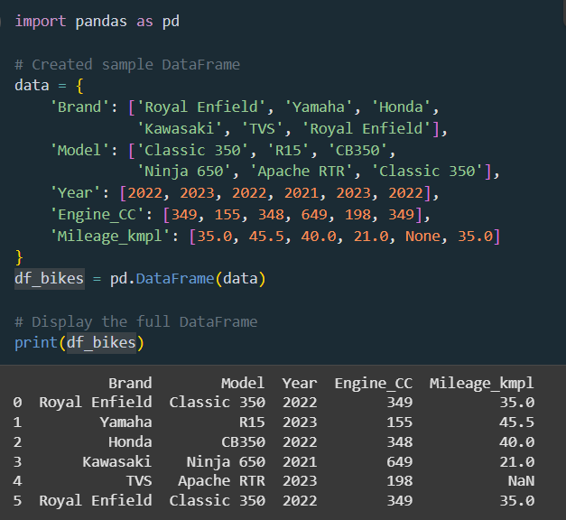
Pandas Basics
What are pandas?
Pandas is a Python module for handling data collections.
It includes functions for analysing, cleaning, examining, and modifying data.
What Is the Point of Using Pandas?
Pandas allows us to analyse large amounts of data and draw conclusions based on statistical principles. Pandas can clean and organise cluttered data sets, making them more understandable and useful.
Import Pandas
Once installing pandas you can import it by using:
import pandas as pd
Getting Started: Loading Your Data
First, you need to get your data into Pandas. This is usually from a file.
Read a CSV File: This is the most common file type for data.
df = pd.read_csv('filename.csv')
Read an Excel File: If your data is in an Excel spreadsheet.
df = pd.read_excel('filename.xlsx')

Slide 16
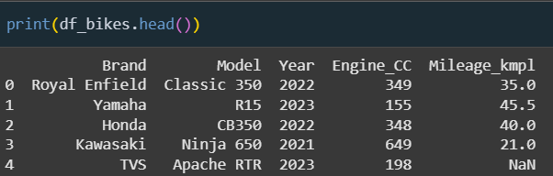
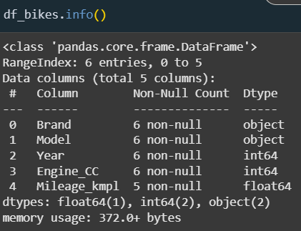
Pandas Basics
Understanding Your Data
Once your data is loaded, you need to get a feel for what it looks like.
Display Top Rows: See the first 5 rows to get a quick sample.
df.head() #by default it's 5
Display Bottom Rows: Check the last 5 rows, which can be useful to see the total count or if the data is sorted.
df.tail() #by default it's 5
Get a Quick Summary: See how many rows and columns you have, the names of the columns, and what type of data is in each column (e.g., numbers, text, dates). This is one of the most useful commands.
df.info()
Get Descriptive Statistics: For all columns with numbers, this calculates the count, mean (average), standard deviation, min, and max values.
df.describe()

Slide 17
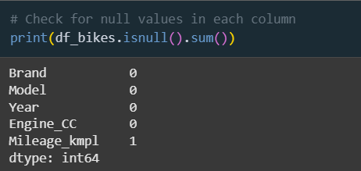
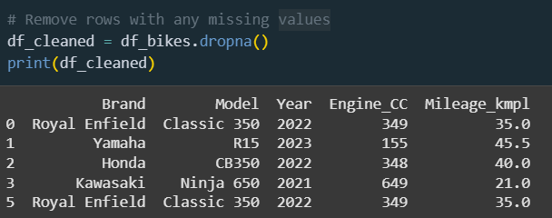
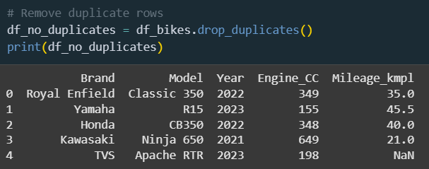
Pandas Basics
Cleaning Your Data
Real-world data is often messy. You might have missing values, typos, or columns you don't need.
Handling Missing Values
Check for Missing Values: This counts the number of empty cells (NaN values) in each column.
df.isnull().sum()
Drop Rows with Missing Values: A quick way to clean up your data is to remove any row that has an empty cell.
df.dropna()
Fill Missing Values: Instead of dropping rows, you might want to fill the empty cells with a specific value (like 0 or the column's average).
df.fillna(0)
Fixing Columns & Rows
Rename Columns: Give your columns clearer, more convenient names.
df.rename(columns={'old_name': 'new_name'})
Drop Columns: Remove columns you don't need to simplify your table.
df.drop(columns=['column_name_to_drop'])
Remove Duplicate Rows: Get rid of any rows that are exact copies of each other.
df.drop_duplicates()

Slide 18
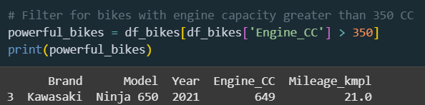
Pandas Basics
Selecting & Filtering:
You often don't need your entire dataset. You need to grab specific parts of it.
Select One Column: To work with just a single column (like a list).
df['column_name']
Select Multiple Columns: To create a smaller table with only the columns you're interested in.
df[['column1', 'column2']]
Select Rows by Position: Grab rows using their numerical position(e.g., the first 5 rows). Remember, Python starts counting at 0! ​
df.iloc[0:5]​
​
Conditional Selection: This is a superpower! You can filter yourdata based on a condition. For example, find all rows where the 'age'column is greater than 30.​
df[df['age'] > 30]​

Slide 19
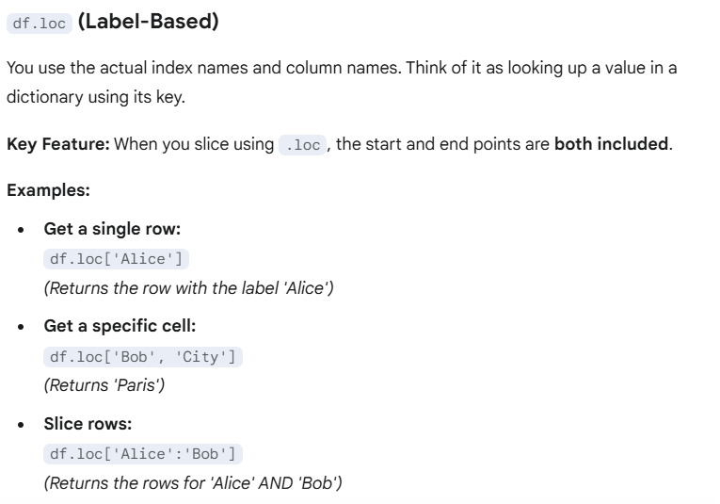
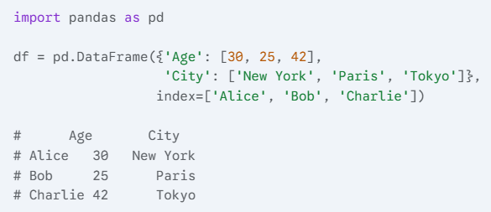
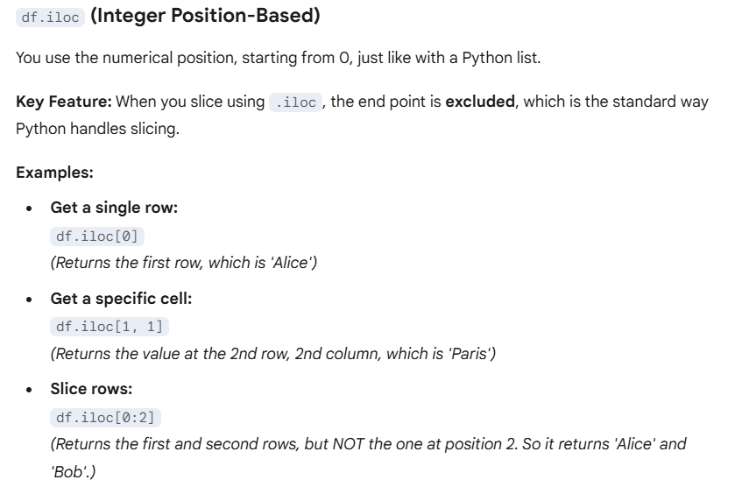
Pandas Basics
Difference between loc an iloc
The main difference is how you select data: .loc uses labels, while .iloc uses integer positions.
.loc gets data by the name of your rows and columns.
.iloc gets data by the position number (index) of your rows and columns, starting from 0.

Slide 20
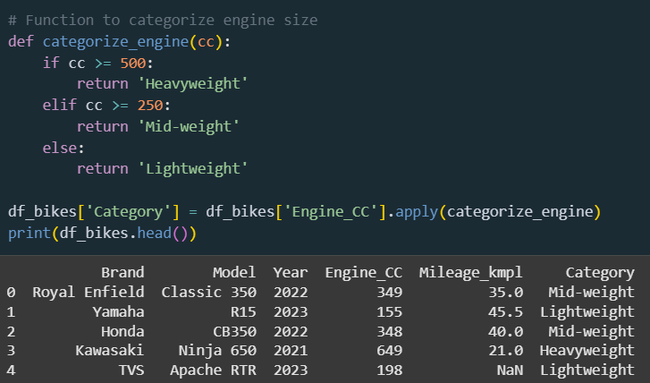
Pandas Basics
Transforming Data
You can start changing your data, doing calculations, and organizing it in new ways.
Apply a Function to a Column: Perform a custom operation on every value in a column. For example, convert a temperature column from Celsius to Fahrenheit.
df['celsius_temp'].apply(lambda x: (x * 9/5) + 32)
Group By and Aggregate: This is incredibly powerful forsummarizing data.You can group all your rows by a certaincategory (like 'City') and thencalculate an aggregate foreach group (like the average 'Salary' per city).
df.groupby('City').agg({'Salary': 'mean'})

Slide 21
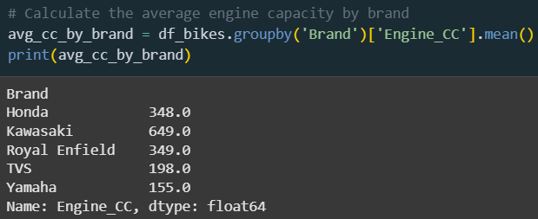
Pandas Basics
Merge DataFrames: Combine two separate tables intoone, based on a common column (like an ID). This issimilar to a VLOOKUP in Excel.​
pd.merge(df1, df2, on='ID_column')​
​
Change a Column's Data Type: Sometimes Pandasguesses the wrong data type (e.g., a number is read as text).You can fix it manually.​
df['column'].astype('int')​

Slide 22
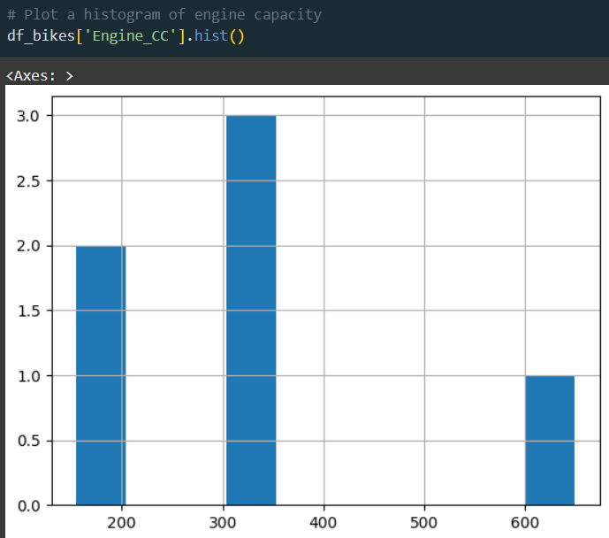
Pandas Basics
Visualizing Your Data
A picture is worth a thousand rows. Basic plots are built right into Pandas.
Histogram: See the distribution of a numerical column. Great for understanding how frequently different values appear.
df['age'].hist()
Bar Chart: Compare quantities across different categories.
df['category'].value_counts().plot.bar()
Scatter Plot: See the relationship between two numerical columns. Are they related?
df.plot.scatter(x='col1', y='col2')
Correlation Matrix: A table that shows how strongly numerical columns are related to each other. A value near 1 or -1 means a strong relationship.
df.corr()

Slide 23
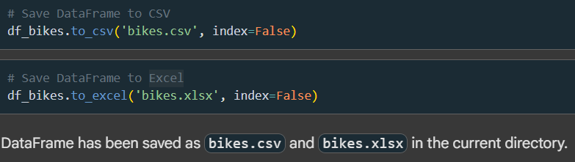
Pandas Basics
Saving Your Work: Exporting Data
Once you're done cleaning and analyzing, you'll want to save your results.
Write to a CSV File: Save your cleaned-up DataFrame to a new CSV file. The index=False part prevents Pandas from saving the row numbers.
df.to_csv('new_filename.csv', index=False)
Write to an Excel File: Save your work to an Excel spreadsheet.
df.to_excel('new_filename.xlsx', index=False)

Slide 24
Comparison of Pandas with SQL

Slide 25
Why compare Pandas and SQL?
SQL is the language of databases, while Pandas is the tool of choice for Python-based data analysis.
Many real-world projects require working with both — e.g., fetching data from SQL, then cleaning and analyzing it in Pandas.
SQL is best for structured, large-scale queries on databases.
Pandas is best for in-memory analysis, custom logic, and integration with Python’s data ecosystem (NumPy, Matplotlib, Scikit-learn, etc.)
Understanding how to “translate” between Pandas and SQL:
Reduces confusion when moving between database and Python environments.
Makes you more efficient in data engineering, analysis, and ML pipelines

Slide 26
SQL Table vs. Pandas DataFrame
A Pandas DataFrame in your Python code is the conceptual equivalent of a single SQL table in a database.
SQL Table (in a database) | Pandas DataFrame (in memory)
Persistent Storage: Stored on a disk. | In-Memory: Lives in your computer's RAM.
Strict Schema: Column data types are fixed. | Flexible Schema: Easily add/remove columns.
Queried with SQL. | Manipulated with Python code.
Key Differences Between Pandas & SQL
Feature | SQL | Pandas
Storage | Disk-based (Databases) | Memory-based (RAM)
Interface | Declarative (you tell what to do) | Procedural (you write how to do it)
Syntax | SELECT, WHERE, JOIN, etc. | Functions and methods (df[...], .merge(), .groupby())
Output | Tables / Views | DataFrames / Series
Performance | Great for very large data | Great for medium data analysis
Language | SQL | Python

Slide 27
Selecting and Filtering (SELECT & WHERE)
Asking for Data: SELECT and WHERE
This is the most common task: selecting specific columns and filtering for specific rows.
Pandas Logic
We use square brackets [] for both. This is called boolean masking.
Pandas Example:
(Assume our data is in a DataFrame called employees_df)
SQL Logic
We use SELECT for columns and WHERE for row conditions.
SQL Example:
Get the name and salary of employees from the 'Sales' department who earn more than 50,000.
SELECT name, salary
FROM employees
WHERE department = 'Sales’
AND salary > 50000;
# Create the condition (the "mask")
condition = (employees_df['department'] == 'Sales') & (employees_df['salary'] > 50000)
# Apply the mask to filter rows, then select columns
employees_df[condition][['name', 'salary’]]
In Pandas :
& is used for AND.
| is used for OR.
Each condition must be wrapped in parentheses ( ).

Slide 28
Combining Tables (JOIN)
Connecting the Dots: JOIN Operations
Joins are used to combine rows from two or more tables based on a related column.
SQL Logic
We use INNER JOIN, LEFT JOIN, RIGHT JOIN, or FULL OUTER JOIN.
SQL Example (LEFT JOIN):
Get every employee's name and their department's name.
Pandas Logic
We use the powerful pd.merge() function. The logic is identical.
Pandas Example (LEFT JOIN):
(Assume we have employees_df and departments_df)
SELECT e.name, d.department_name
FROM employees AS e LEFT JOIN departments AS d ON e.department_id = d.id;
import pandas as pd
pd.merge( left=employees_df, right=departments_df, how='left', -- Corresponds to LEFT JOIN left_on='department_id', -- Key column in the left DataFrame right_on='id' -- Key column in the right DataFrame )
In Pandas :
The how parameter can be 'inner', 'left', 'right', or 'outer'.

Slide 29
Aggregating Data (GROUP BY)
GROUP BY is used to group rows that have the same values into summary rows, often to calculate aggregates like counts, sums, or averages.
SQL Logic
We group by one or more columns and then use aggregate functions like AVG(), COUNT(), SUM().
SQL Example:
Calculate the average salary and number of employees for each department.
Pandas Logic
We use the .groupby() method, followed by the .agg() method to perform calculations.
Pandas Example:
(Assume we have employees_df and departments_df)
SELECT department,
AVG(salary) AS avg_salary,
COUNT(employee_id) AS num_employees
FROM employees
GROUP BY department;
employees_df.groupby('department').agg( avg_salary=('salary', 'mean'), num_employees=('employee_id', 'count') ).reset_index()
# Converts the grouped output back into a clean DataFrame
In Pandas :
groupby('department'): Groups the data by unique department names.
.agg(...): Applies the specified functions (mean, count) to the specified columns (salary, employee_id).
.reset_index(): Turns the grouping column (department) back into a regular column.

Slide 30
Other Common Operations
Here are some other common commands and their Pandas equivalents.
Operation | SQL | Pandas
Sorting Data (ORDER BY) | ORDER BY salary DESC, name ASC; | df.sort_values(by=['salary', 'name'], ascending=[False, True])
Limiting Results (LIMIT / TOP) | LIMIT 10; | df.head(10)
Unique Values (SELECT DISTINCT) | SELECT DISTINCT department FROM employees; | df['department'].unique() or df['department'].drop_duplicates()
Creating a New Column | SELECT salary, salary * 0.1 AS bonus FROM employees; | df['bonus'] = df['salary'] * 0.1
Conditional Logic (CASE WHEN) | CASE WHEN salary > 100000 THEN 'High' ELSE 'Normal' END | import numpy as np df['category'] = np.where(df['salary'] > 100000, 'High', 'Normal')
Window Function | SELECT name, salary, RANK() OVER (ORDER BY salary DESC) AS rank FROM emp; | df['rank'] = df['salary'].rank(ascending=False)

Slide 31
When to Use Which?
It's not about which one is "better," but which is right for the task.
Use SQL:
Your data is in a relational database.
You are dealing with massive datasets (billions of rows) and need to efficiently pull a smaller, manageable subset.
Data integrity, security, and concurrent access are critical (e.g., in a production application).
You are performing data extraction and basic transformations at the source.
Use Pandas:
Your dataset can fit into your computer's RAM.
You are performing exploratory data analysis (EDA) within a Python environment (like Jupyter).
You need to do complex data cleaning, transformation, and statistical analysis.
You need to integrate with other Python libraries for machine learning (scikit-learn) or plotting (matplotlib, seaborn).
Best Practice: Use them together! A common workflow is to use SQL to extract and filter the data you need from a large database, then load that subset into a Pandas DataFrame for detailed analysis.

Slide 32
Pandas: Data Cleaning

Slide 33
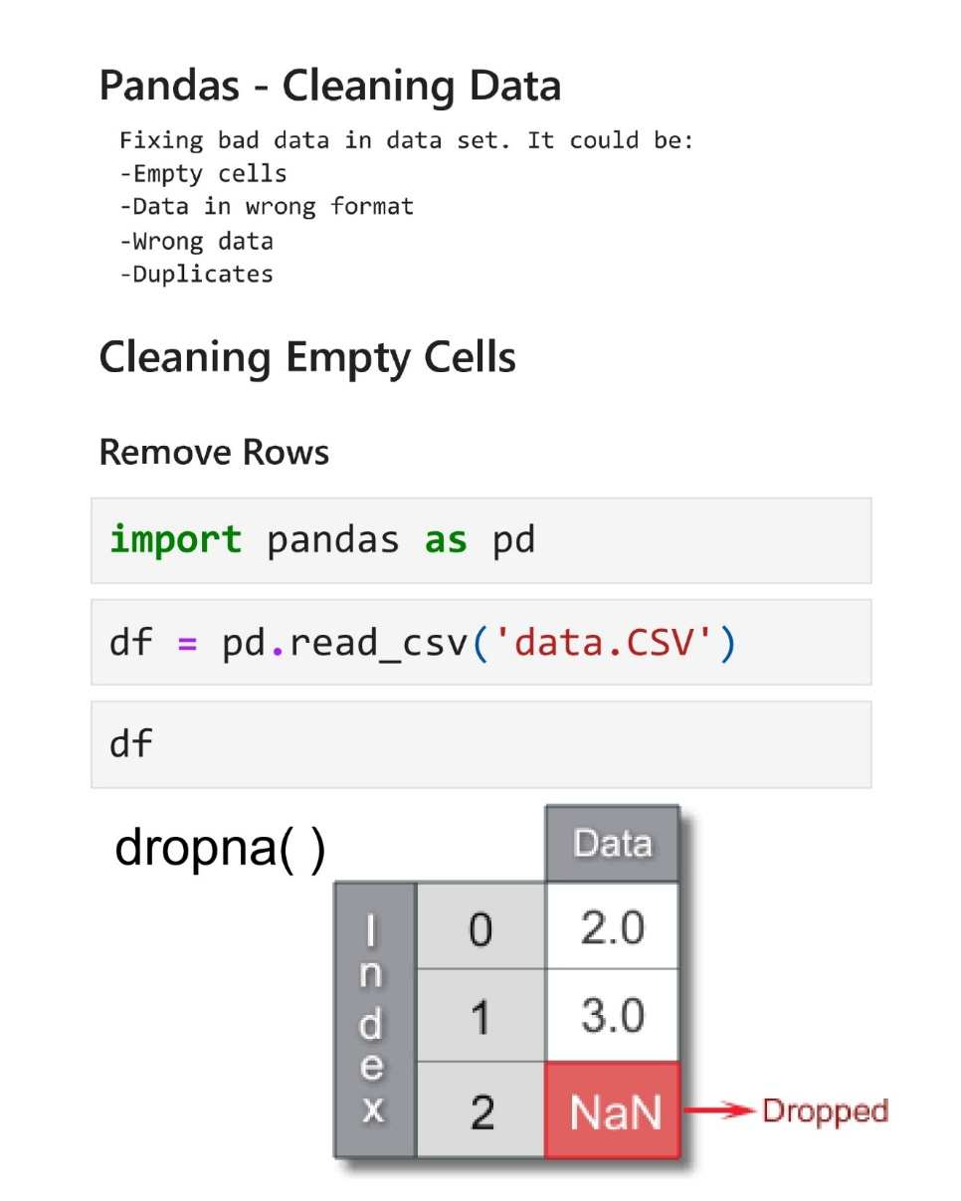
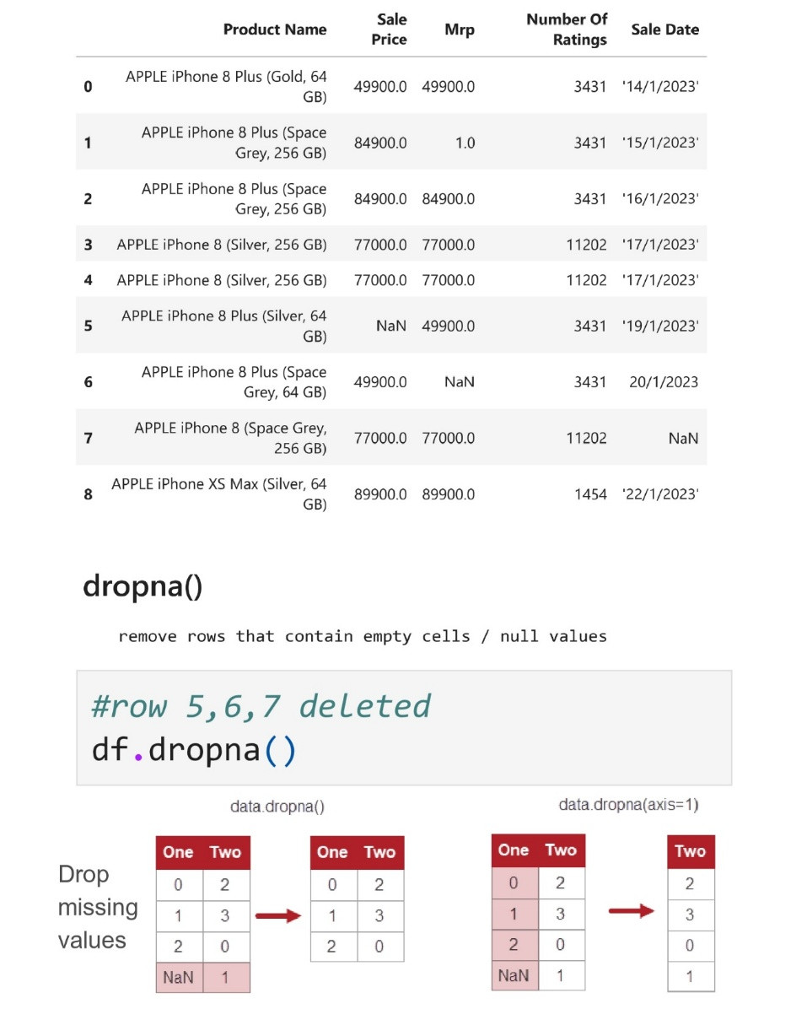
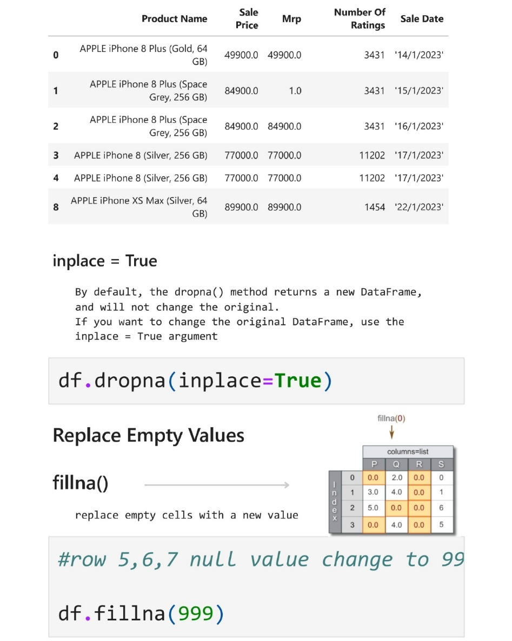
Data Cleaning

Slide 34
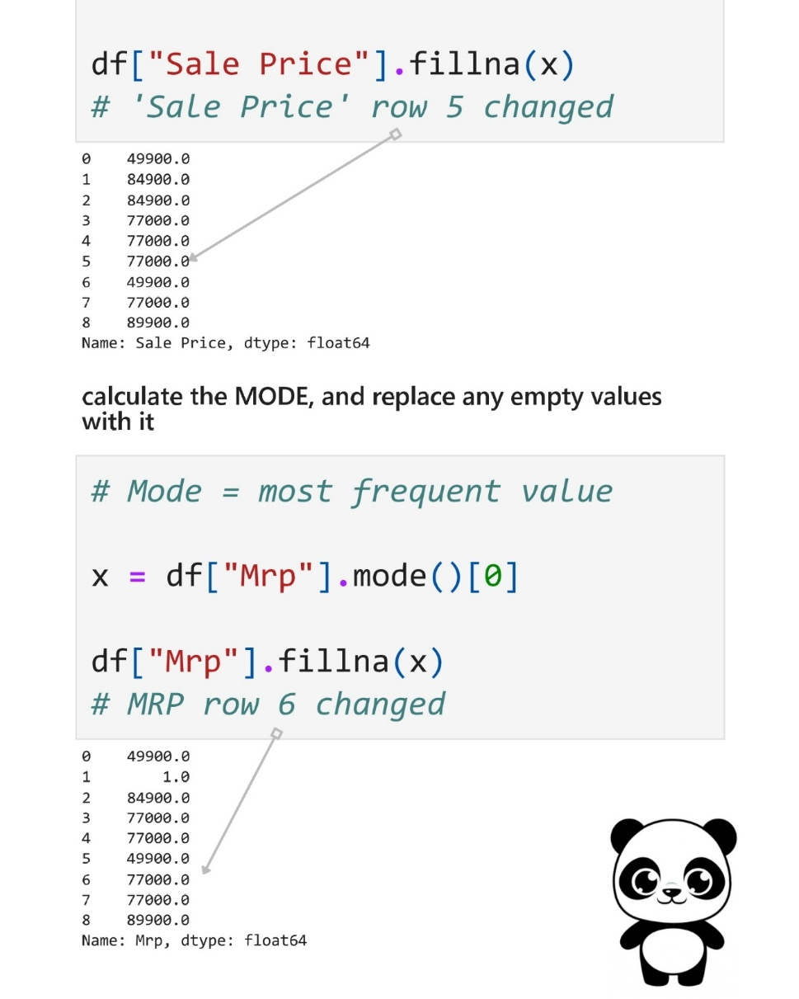
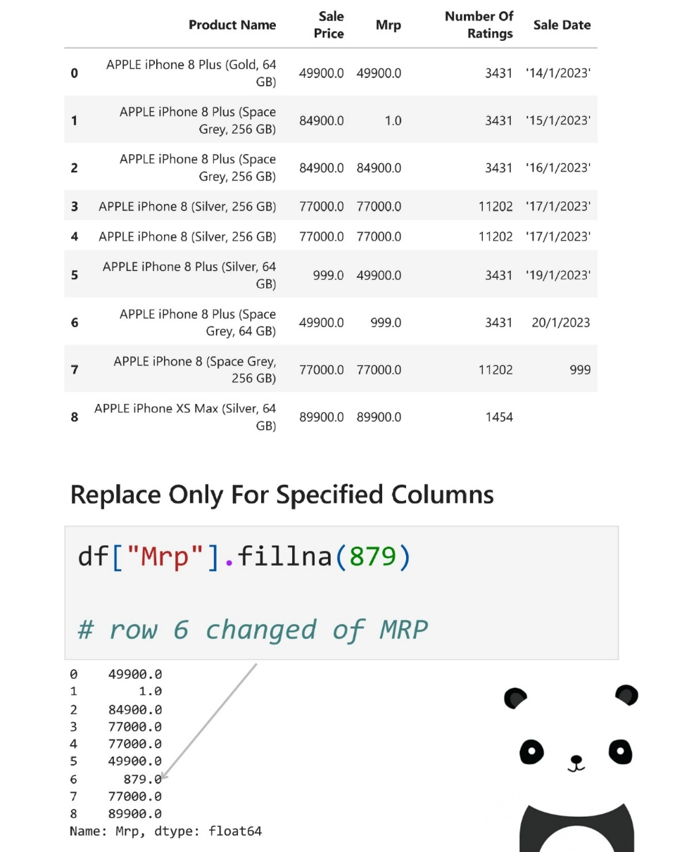
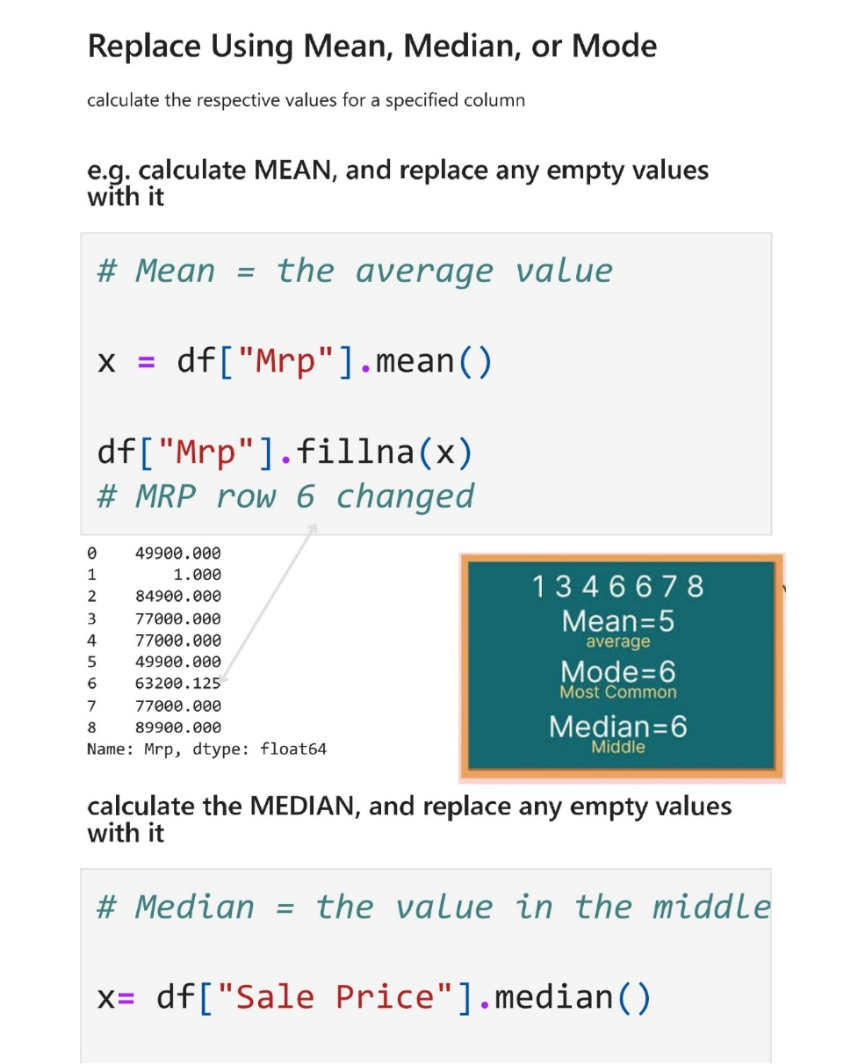
Data Cleaning

Slide 35
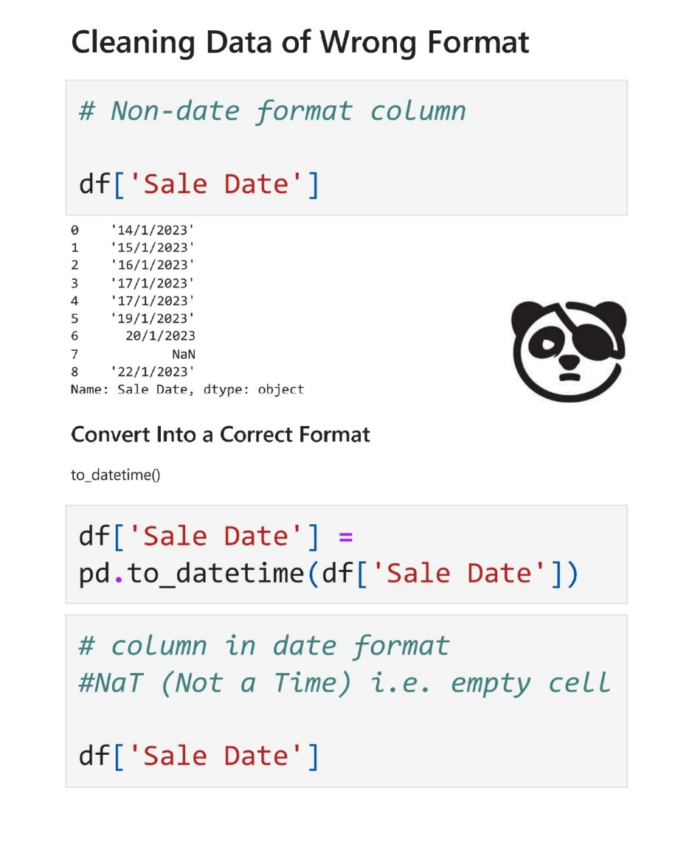
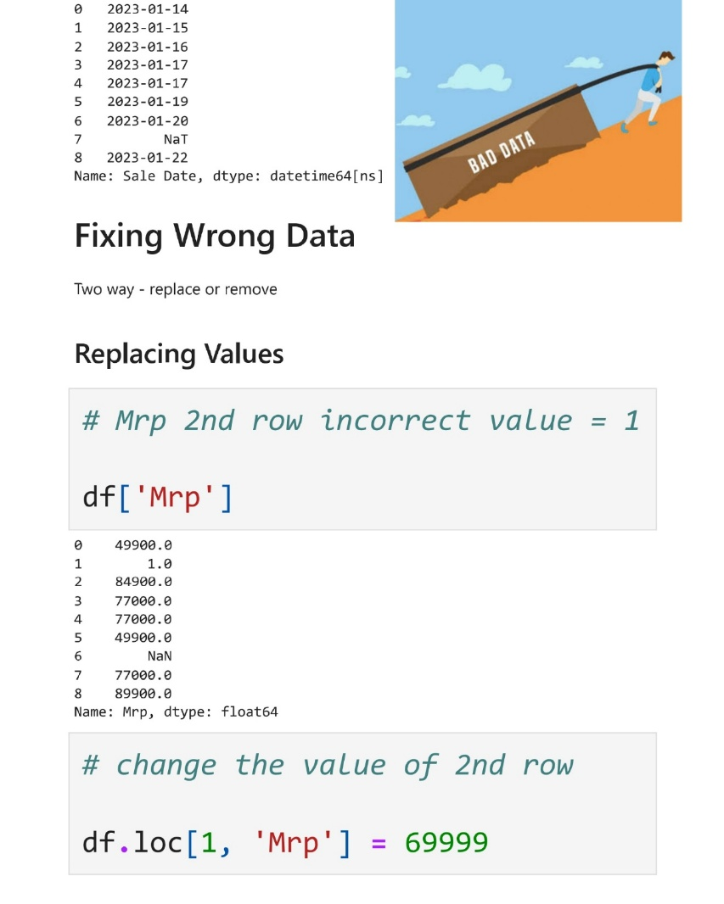
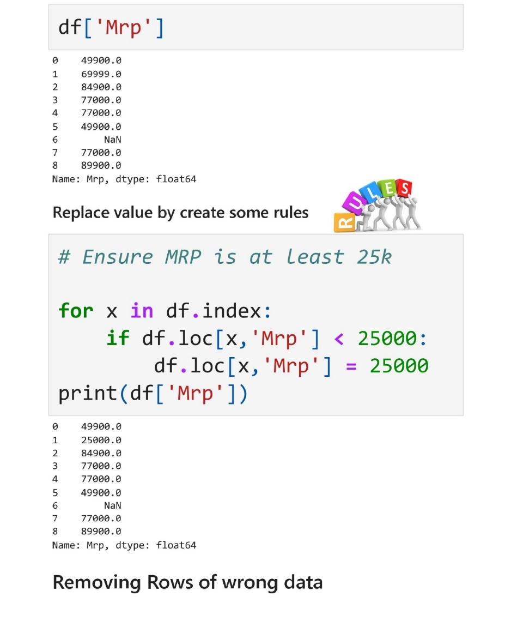
Data Cleaning

Slide 36
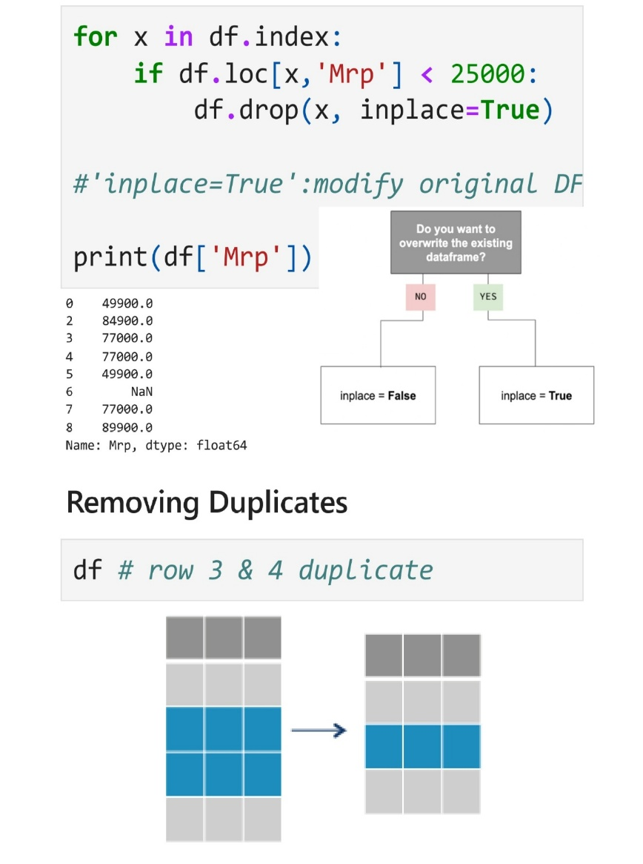
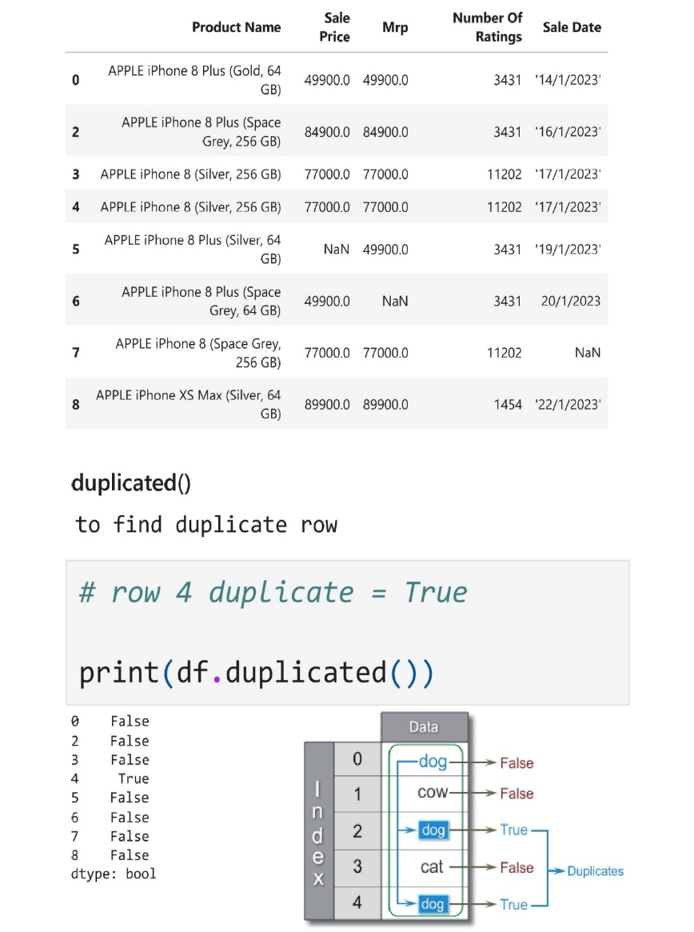
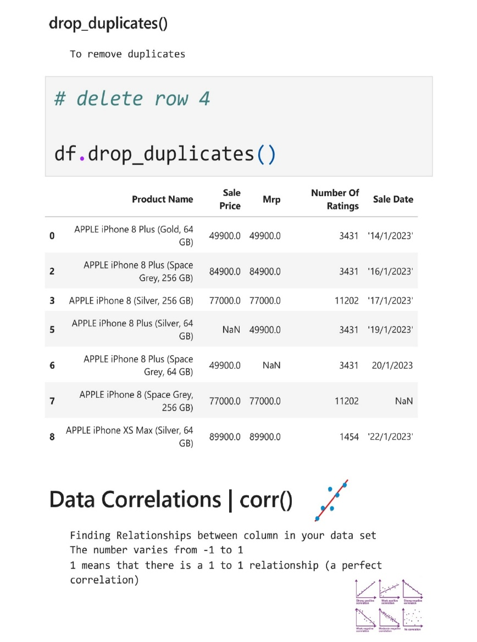
Data Cleaning

Slide 37
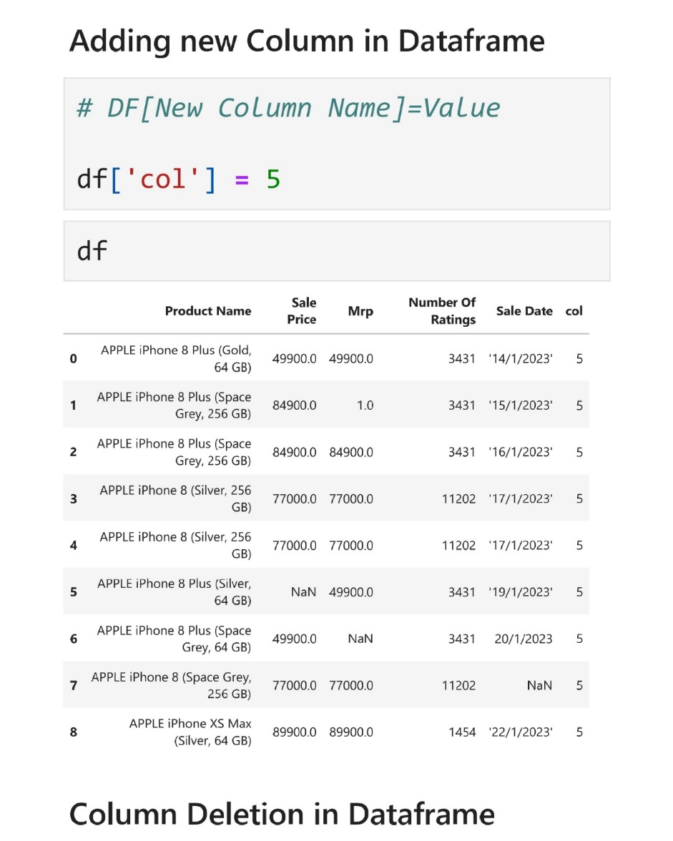
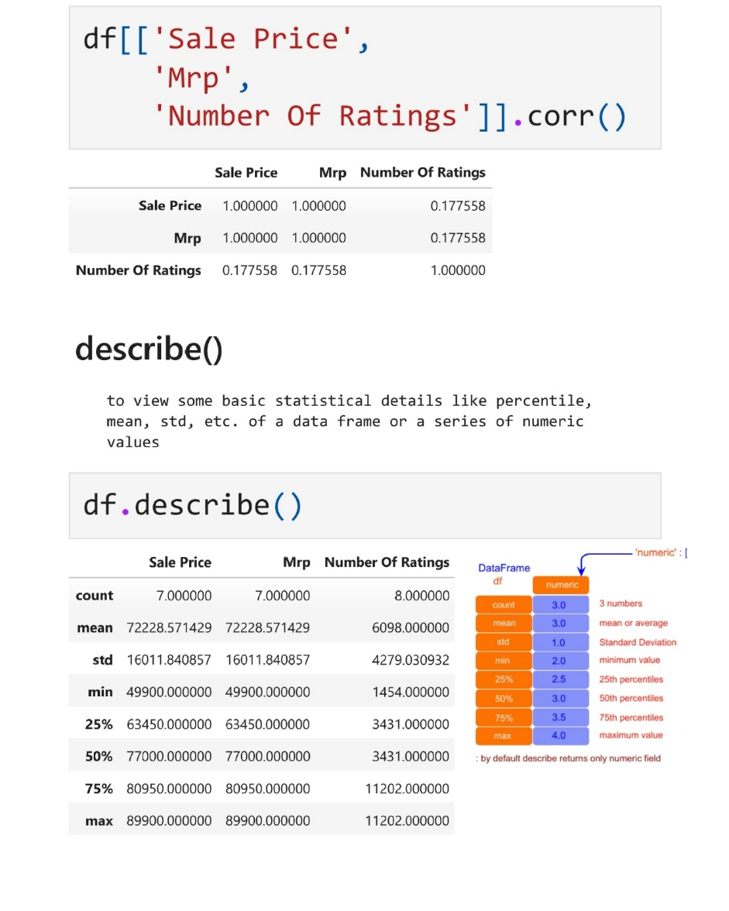
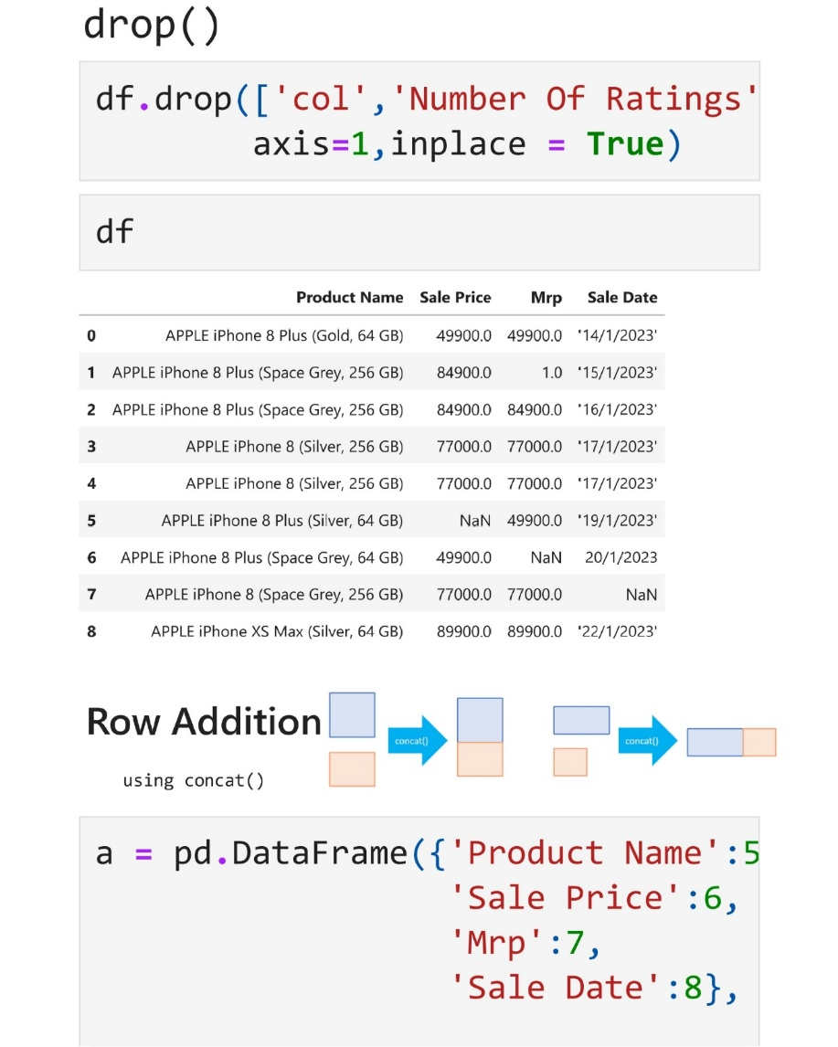
Data Cleaning

Slide 38
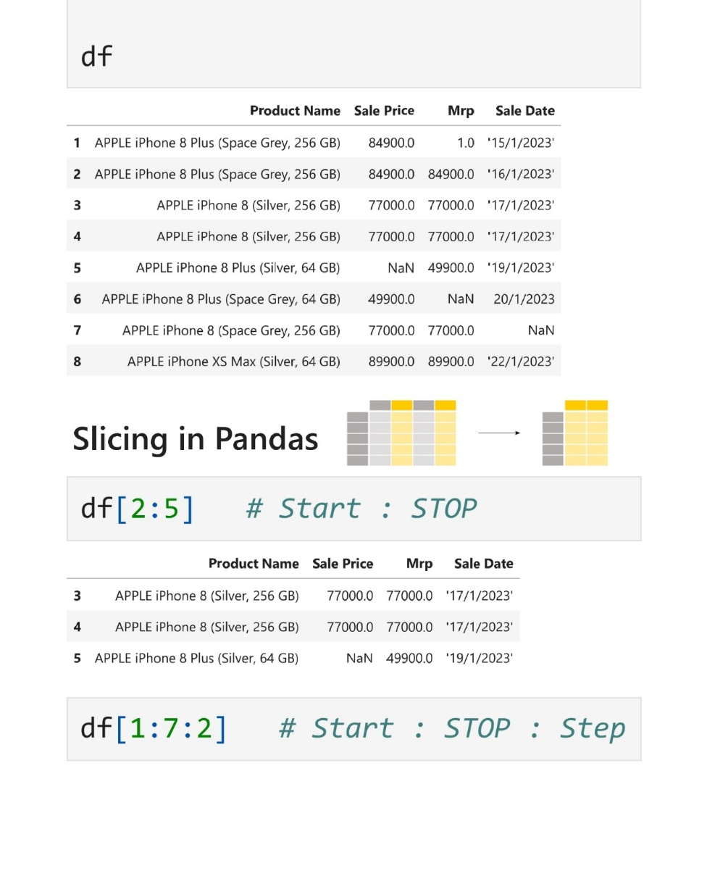
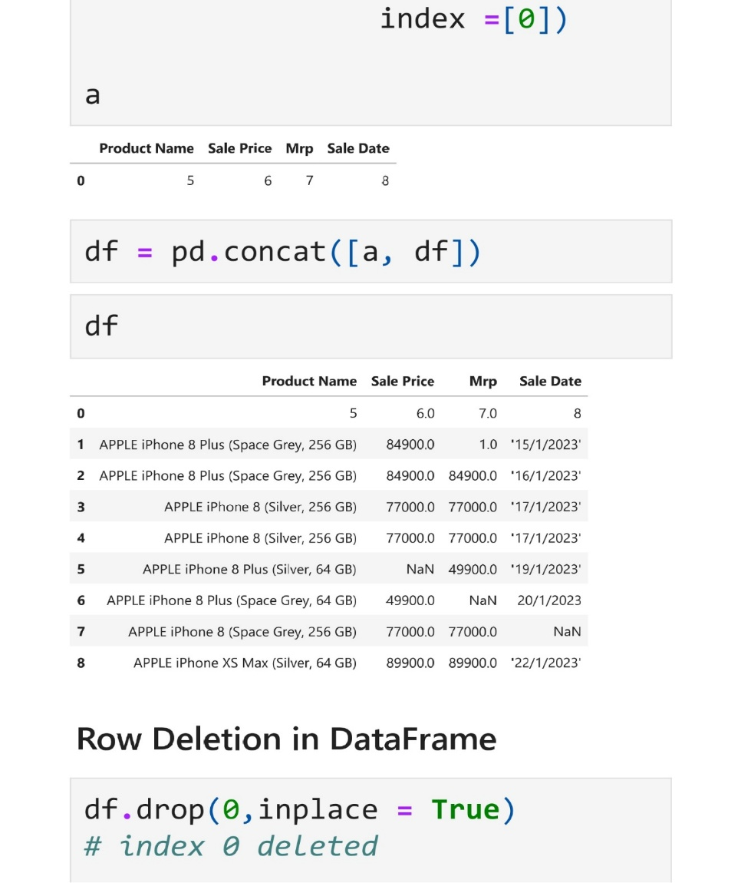
Data Cleaning

